Slide 1


Climate Change Impact Platform
Machine Learning to Extract Actions and Guidance
Final Project Presentation
Haiying Man, Kalpita Dapkekar
Eian Stern, Aakar Mathur
Austin Kim, Peter Petrillo

Slide 2

Objective
Our goal was to build upon the previous code worked on by previous intern teams in order to further the climate change application.
In our project scope, we decided upon three areas with which to work on and expand:
1) Improvement of the sentence extraction process
2) The use of Amazon Rekognition's API to extract text from images
3) Using sentiment analysis to understand the criticality of imperative sentences.

Slide 3
PDF to Text conversion
To start extracting information from PDF files, our first step was to convert PDFs into a txt file
Four different tools were tested: PDFPlumber, PyPDF2, PDFMiner, and a third party website converter
The third party website was simple to use as minimal code was required
However, it was clear it did not extract as much text as the python tools

Slide 4
PDF to Text conversion
While testing different PDF files with the tools, there were a few reoccurring problems:
Random characters and blank spaces would be output
Certain PDFs were not converted as well as others
Sentences were split
Bullet points could not be processed
While PDFPlumber and PyPDF2 were very easy to use, their outputs were not as consistent and clean as PDFMiner
PDFMiner provided the cleanest results and least problems

Slide 5
Sentence Extraction
Sentence extraction involves taking what is deemed as relevant information from the text.
To accomplish this, certain hard-coded rules were implemented to filter out relevant from non-relevant information
However, what is perceived as important/relevant information is subjective to the type or category of text that is being used (e.g. scientific/academic texts, government-issued texts)
Thus, this suggests that a possible approach to this problem is the classification of texts and subsequently altering the rules that define what is relevant information based upon classification.

Slide 6
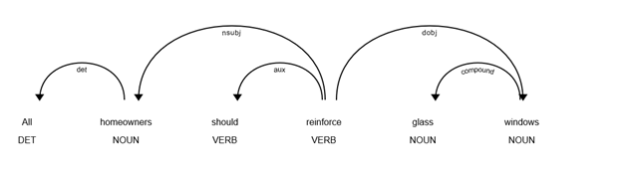
Sentence Extraction
In creating the rules for sentence extraction, we used the parts of speech tagging available through the spaCy library.
This particular graph shows the relations amongst the words of the sample sentence “All homeowners should reinforce glass windows.”
We can use make use these POS and the preexisting relations amongst words for our purposes of extracting action from climate change documents.

Slide 7
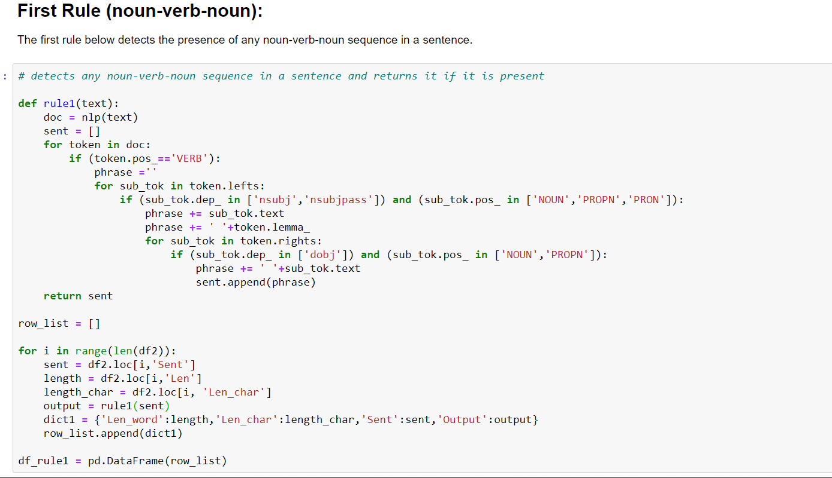
General Rules
A sentence generally contains a subject – action – object (noun-verb-noun) format with the rest of the sentence acting as support to give additional information.
This general sentence structure can be leveraged to extract the main focus of the sentence.

Slide 8
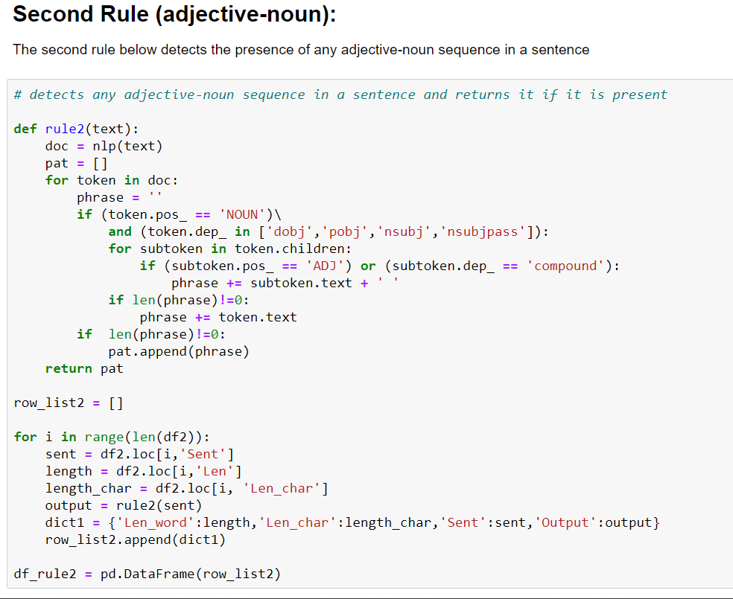
General Rules
The presence of adjectives or words with compound dependency enhance the meaning of the noun and overall sentence

Slide 9
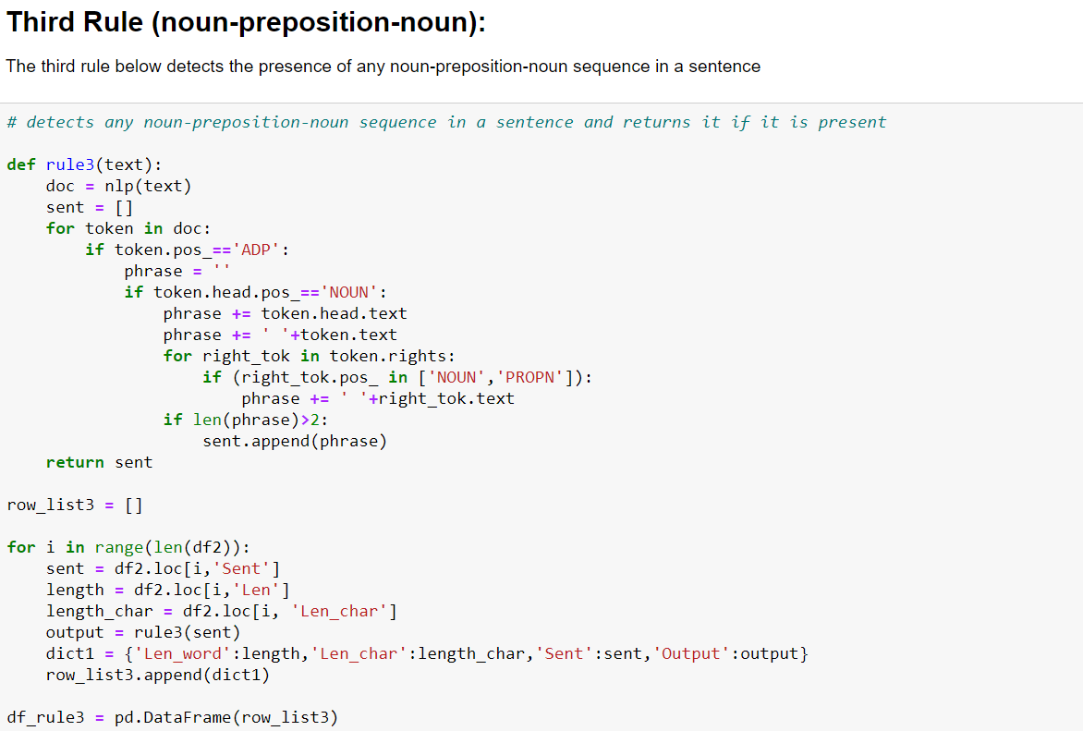
General Rules
Prepositions are indicators of where or when something is in a relationship with something else

Slide 10
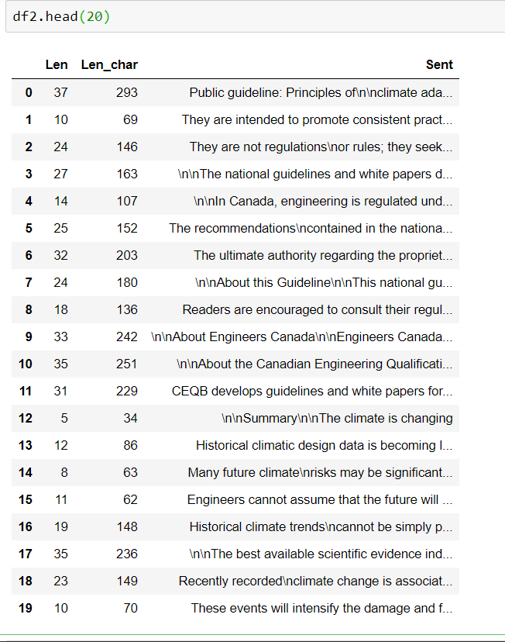
Creating the DataFrame
Before applying our general rules, we must organize the texts by sentences.
In order to do this, we created a dataframe with each row containing the sentence, the word count, and character count
The file used in the example can be found on <public_guideline__principles_of_climate_adaptation_and_mitigation_for_engineers.pdf>

Slide 11
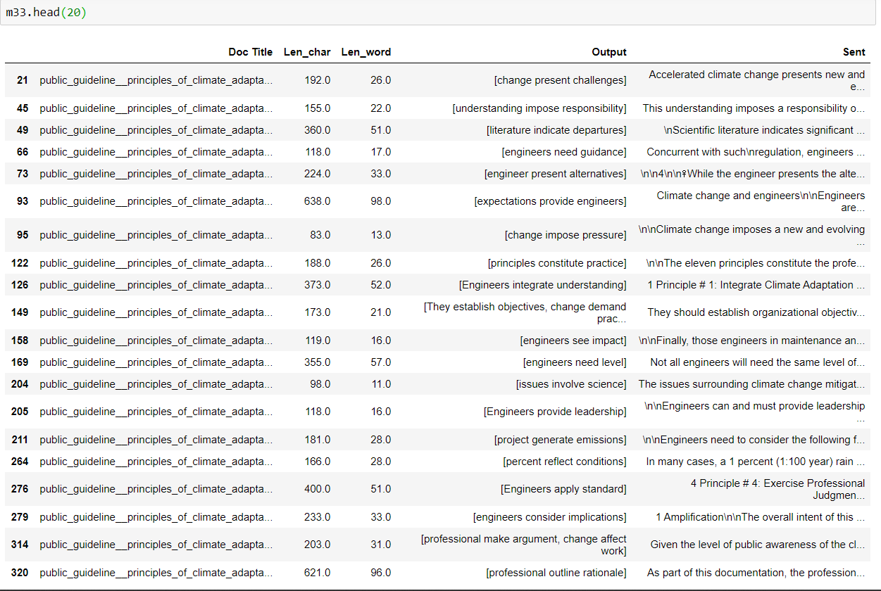
Processing the DataFrame
With our foundation dataframe, we can start to process the sentences found within the text
We used the first general rule to detect any noun-verb-noun sequence within each sentence and checked for the presence of certain keywords
The full Excel sheet containing sentences that passed through rule 1 and the keyword check can be found here

Slide 12
Refinement of Rule-Based Extraction
The results of these sentences show that there are sentences that are relevant but there also exist some undesirable results.
Some extracted sentences are important informational sentences that are good to know but not very important in everyday use for the average citizen. For these cases, it is likely best to filter out this type of information.
The preliminary results of extracted sentences make use of primarily the first rule that detects noun-verb-noun sequences.
The keyword filter can be further built upon
The other two general rules can also be incorporated into after making them have more nuanced ruling (as the current general form is too open-ended for effective use)
Some "sentences" contain multiple sentences and other anomalies due to formatting issues stemming from PDF-to-text conversion

Slide 13
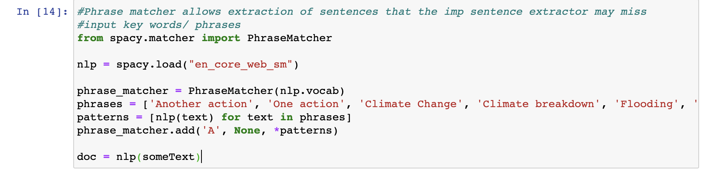
Key Phrase Extraction
The use of spacy's key phrase matcher was experimented alongside the rule-based extraction
The key phrase matcher allows for sentences containing specific words or phrases to be extracted from the text that the rule-based extraction may have missed
Results were promising until integrated with the rule set
When integrated, the extracted text had repetitive results of the same lines with irrelevant information

Slide 14
Grouping of Files By Category
The files we use all belong to different categories
It is in our interest to divide these files up accordingly by group (e.g. scientific, government, pamphlet, etc)
If we are to further refine the rules-based extraction process, the classification of files by categories would allow for nuanced rules/keyword that will better enable accurate sentence extraction
Text categorization is important to this project as it allows for eventual automatic text organization
One method of tackling text categorization is through k-nearest neighbor classification

Slide 15
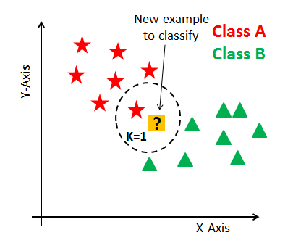
K-Nearest-Neighbor Classification
K-nearest neighbors (KNN) is a lazy, supervised machine learning algorithm.
In order to classify new data points, the KNN algorithm calculates the distance of a data point to other training data points where the distance can be of any type (Euclidean, Manhattan, etc).
Next, the k nearest data points are found where k is integer-valued. Then, the initial selected data point is classified to a label according to what the majority of the k nearest data points belong in.
The advantage of KNN lies in its ease of implementation. Despite the fact that there may be more fitting methods, the KNN algorithm is proven to overall provide relatively accurate results in spite of its simplicity.

Slide 16
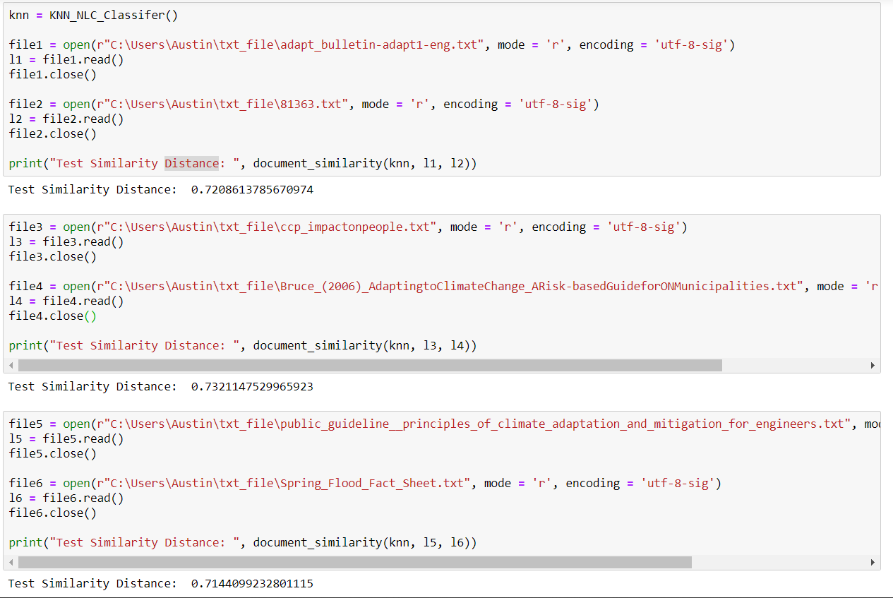
KNN on Climate Change Files
The KNN algorithm can be used to classify by finding the K-nearest matches in the training data and then using the label of the closest matches for prediction
Traditionally, a metric like Euclidean distance is used to find the closest matches.
For text classification purposes, we will create a similarity rating between texts that measure how similar documents are to each other. The similarity rating will be used in lieu of traditional measures of distance.
Code can be found here

Slide 17
Continuing Text Classification
The similarity score is a number between 0 – 1 and acts as a substitute indicator for distance in our KNN algorithm.
Now that we have a measure for distance, the next step would be to write methods to train the model on a set of texts so that it can make predictions. However, before feeding the model training data, we must do some preprocessing of the data which includes but is not limited to:
removing unnecessary stopwords, converting all upper-case characters to lower-case and possibly excluding non-alphabetic characters
preparing a well-rounded set of training data for the model to learn on

Slide 18
Extracting Images from the PDF files
With python, various libraries allow you to extract images from the pdf files.
PyMuPDF module which will extract images from the PDF file using fitz library in PNG format.
This library will extract all the images from PDF file.
How does it works? This library scans through all the objects present in the PDF and selects Type/XObject with /Subtype/Image.
Runtime of extracting all the images depends on number of objects in the PDF.
If there are more pages in the pdf(1000 pages), this library will enable us to find the image on the specific page which will help us to reduce time in extracting all the images and save storage.
And will be storing all the images in Amazon S3 bucket.

Slide 19
How Image Rekognition works for detecting objects?
Step 1 – Analyzing an Image stored in Amazon s3 bucket.
Step 2 - Correcting Image Orientation and Image Resizing(Image with different sizes may result in different outputs).
Step 3 – Use DetectLabels API operation to detect objects, concepts, and scenes in image.
Response from DetectLabels is an array of labels detected in the image and the level of confidence by which they were detected.
Response also includes the ancestor labels for a label in the Parents array.
One of the feature that is custom labels can be used to identify the objects and scenes in images that are specific to your needs by training a machine learning model

Slide 20
How Image Rekognition works for detecting text? ​
Step 1- Amazon Rekognition text detection can detect text in images using DetectText API.
Step 2- It can then convert the detected text into machine-readable text.
DetectText API can detect up to 50 words in an image and detects numbers and common symbols such as @, /, $, %. -, _, +, *, and #.
The response of the DetectText operation will be an array, where each element represents a line or word detected in the image.
Response also returns some other information such as relationship between words and line, location of the text on the image, confidence score and type of the detected text.

Slide 21
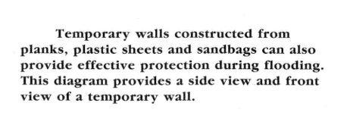
Rekognition: Acquiring the images
The following tools were used: S3 storage (AWS Service for storing the images), Boto3 Python
There are a lot of valuable information in some of the images inside of the PDF files that go undetected because the current application is only able to detect machine-readable text
By implementing Amazon Rekognition's API, text in images can be detected, broadening the capablities of the climate change application
To acquire the images, I sorted through images in PDF files that had actionable descritions. There were many images that did not have relevant information to the climate change application, so it was important to sort through the data and acquire images that were relevant.
This is text from an image that was used. It has clear actionable descriptions that people can take to mitigate flooding effects in their homes.

Slide 22
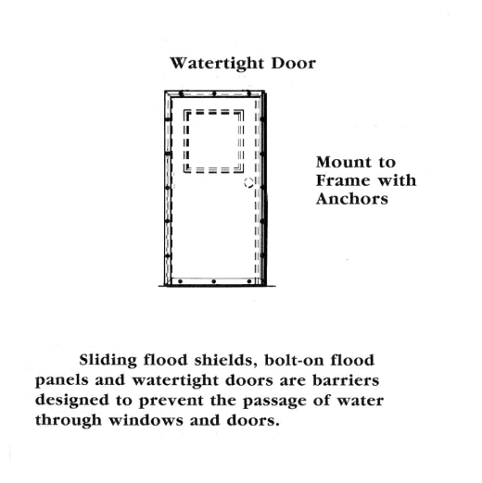
Extracting text from the image
This is a snippet of what gets printed after running the code for Rekognition using DetectText:
Detected text: Watertight Door
Confidence: 99.91%
Detected text: Mount
Confidence: 99.90%
Detected text: to
Confidence: 99.84%
Conclusion: Rekognition was able to detect and print out every word accurately and successfully.

Slide 23
Issues with rekognition
The main goal for Rekognition was to extract text from images so that it would enhance the capabilities of the climate change application which currently is only able to read machine-readable text.
Our goal was met, but the code is not as efficient as we would want it to be. The code can only detect text from one image at a time, because the name of the picture is manually assigned to a variable. In order to extract text from another picture, we would have to go into the code, and change the name of the picture accordingly. This is not productive or efficient especially for mass data ( or in this case, mass amounts of images)
In attempt to adress this issue, I tried to automate the listing of the names of the images so that we would not have to manually write in the image names. After trying different variations of code, there was no success with automating the list of names. I was running into issues where the code would have no errors (exit code 0) but still would not return the list of image names

Slide 24
Next steps / improvement
1) Automate the listing of the image names so the code for Rekognition does not have to be manually changed to accomodate for new images
2) For this version of Rekognition, the images were acquired by manually sorting through PDF files. This is not efficient for mass data. As a next step for improvement, something can be implemented in the beginning so that it sorts through the PDF files for images.
After the images are detected, have Rekognition detect text within those images. Rekognition will be able to detect images with no text, which can then be filtered out since it is trash data. The remaining images will all have text. Using the imperative sentence extraction, we can filter the images even more so that only images that has actionable text are left behind
These next steps would decrease the need for human intervention and improve the functionality of the climate change application

Slide 25
Keywords and phrases extraction
-
With the goal of contribution in mind we sought to extract keywords and phrases to start with to see if it could be used by other team members for further analysis.
For PDf to text conversion we started with pdftotext but encountered problems with the installation.
After several man hours on the worldwide net we realized a library named 'poppler' needed for the installation has not yet been released for the windows system.
So we used PyPDF2 to extract the text data from the pdf.
We could clearly see that pypdf2 translation wasn’t perfect for a few pdf files such as failing to read the letter 'f' in a lot of words.

Slide 26

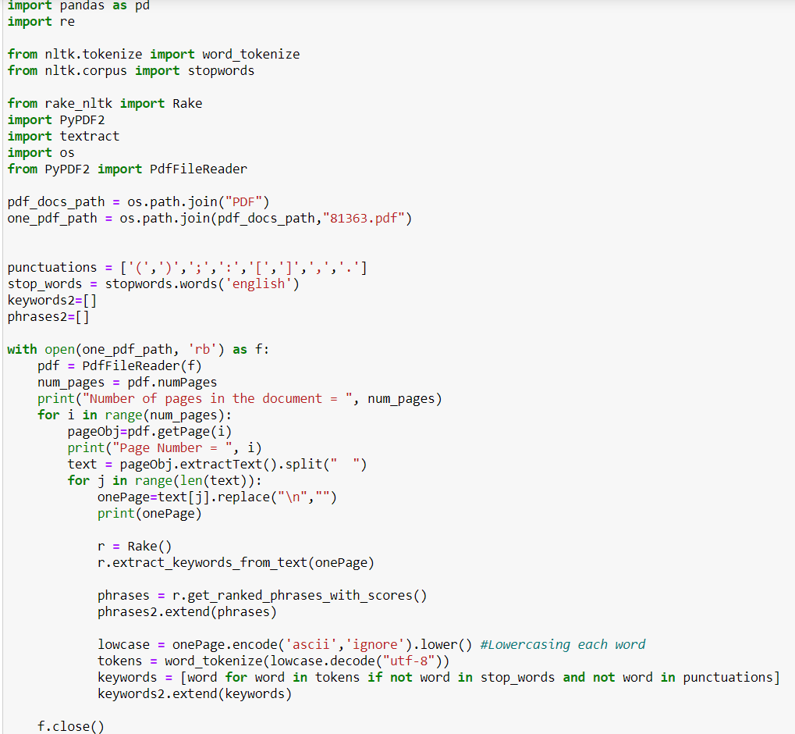
Keywords and phrases extraction
To extract keywords the tokenize method of NLTK library was used.
A separate data frame for all the keywords was made.
To extract phrases the RAKE (Rapid Advanced Keyword Extraction) library was used.
The results were stored in a separate data frame and an excel file and sorted according to thier frequencies.

Slide 27

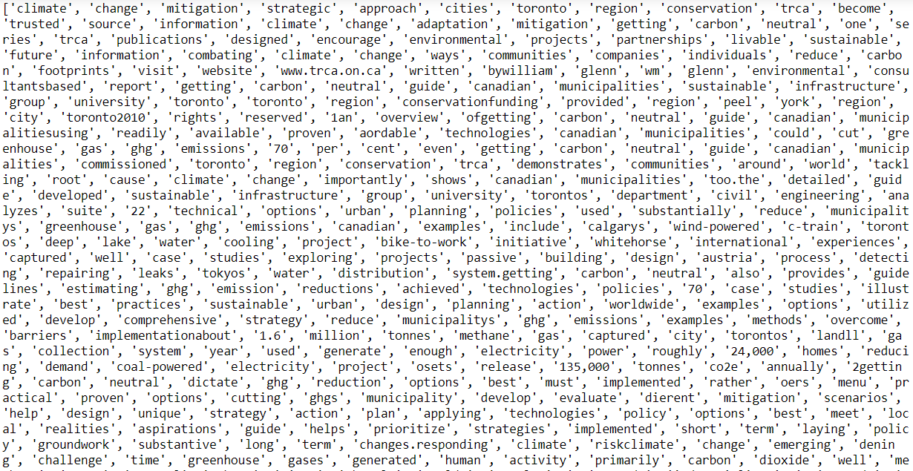
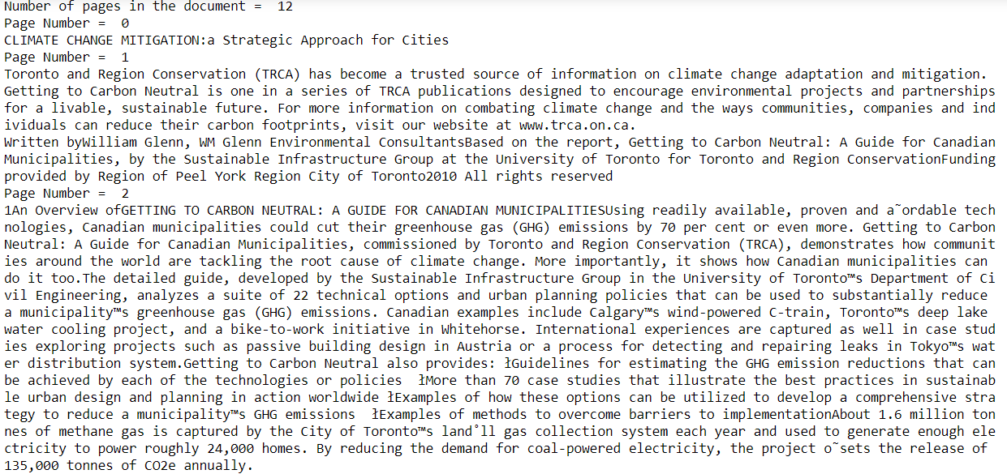
Keywords and phrases extraction
-

Slide 28
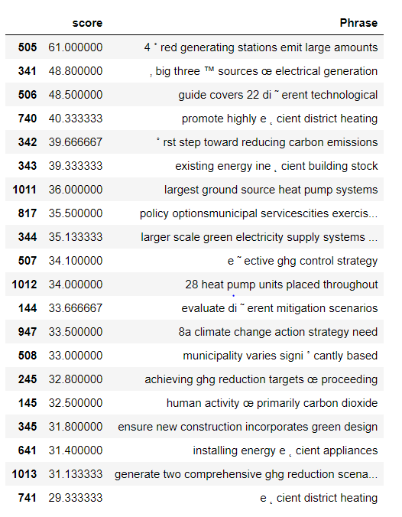
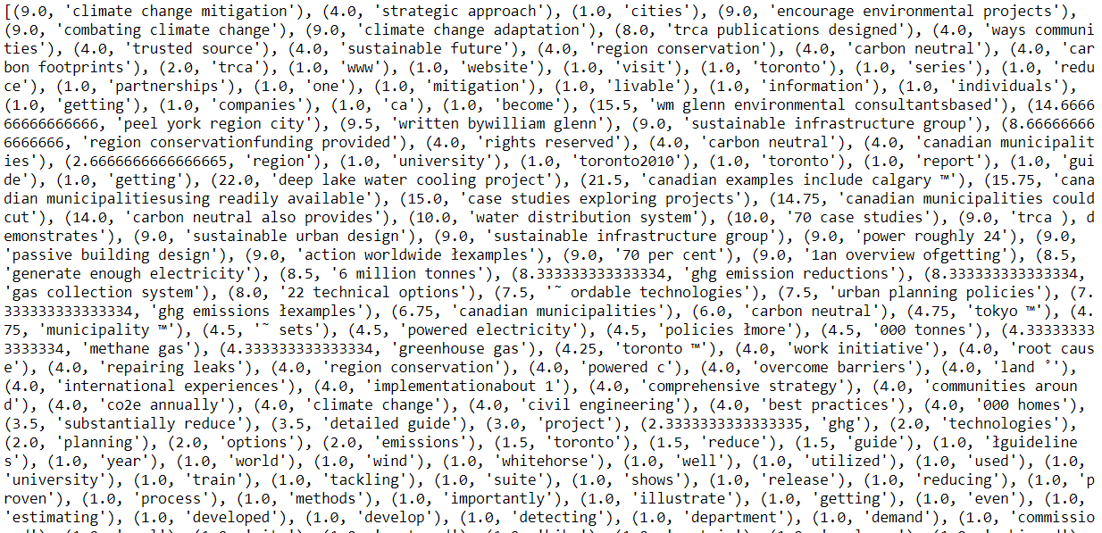
Keywords and phrases extraction
-

Slide 29
Sentiment Analysis
Sentiment Analysis, is a part of natural language processing that is the interpretation and classification of emotions or sentiments of a body of text.
Determines whether a sentence has positive, negative or neutral tone resulting in a compound score.
In our case it would mean how critical an imperative sentence is on a scale of 1 to 3
We sought to use the new VADER library in python.
VADER Sentiment Analysis. VADER (Valence Aware Dictionary and Sentiment Reasoner) is a lexicon and rule-based sentiment analysis tool.
VADER uses a combination of A sentiment lexicon which is a list of lexical features (e.g., words) which are generally labelled according to their semantic orientation as either positive or negative.
Does not severly suffer from a speed performance trade-off.

Slide 30
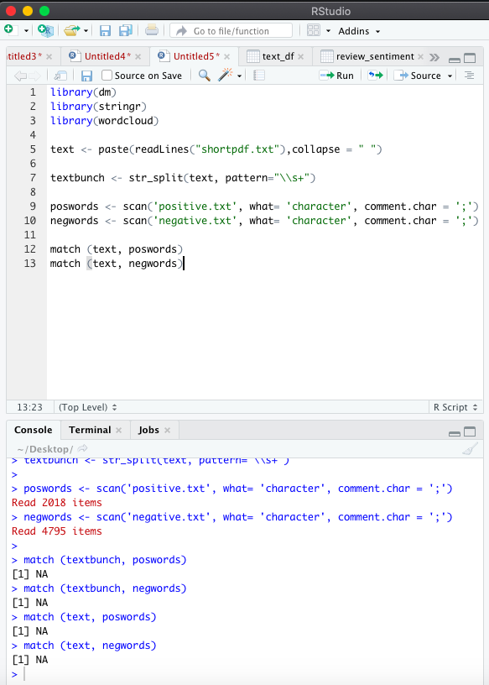
Sentiment analysis using R studio
R packages such as tidytext, stringr, and dm (dataminer) can be useful in extracting text to then determine the sentiment of words in that text.
Originally was going to use tidy text but then decided that just using the dm package would be better.
Created a text file containing 2018 positive words and 4795 negative words.
Then matched the PDF file ("A Practitioners Guide to Climate Change Adaptation in Ontario's Ecosystem") to each word listed.
Unfortunately, there were no matches to positive or negative words in this PDF.

Slide 31
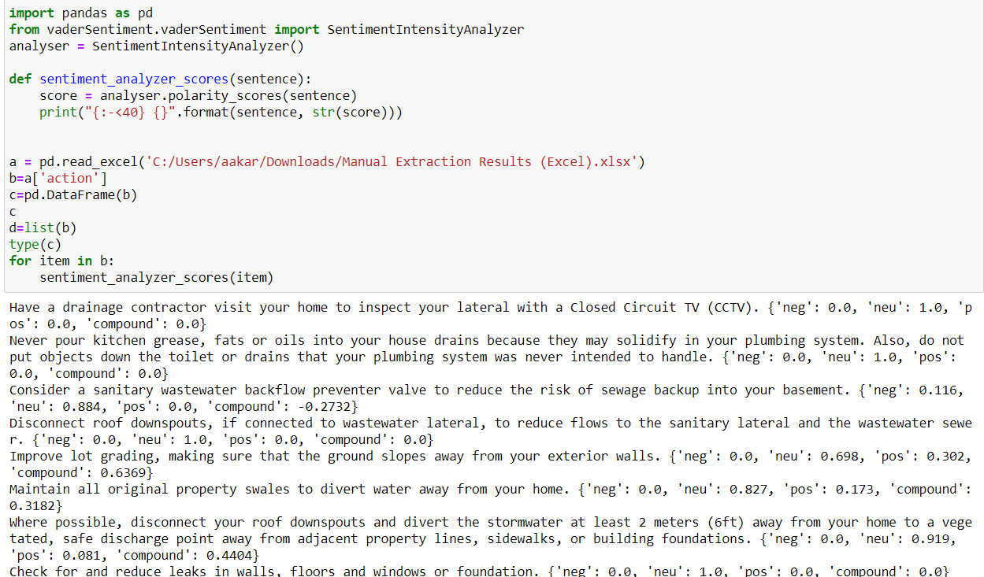
Sentiment Analysis

Slide 32
Moving Forward
If we were to continue working on this project we would:
Define more rules for extraction and refine rules
Continue with KNN classification to automate categorization of document files
Conduct a fine-grained Sentiment Analysis instead of a simple one and look for patterns.
Automate listing of image names so that the code does not have to be manually changed to accommodate for new images
Sort through the PDF files to acquire images with machine learning instead of manually
Filter the images even more by using sentence extraction so only images with actionable text are left behind

